Slide 2

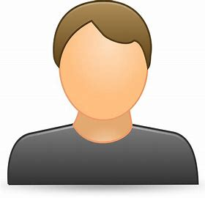
There are 2 logins
Admin
User

